Slide 1
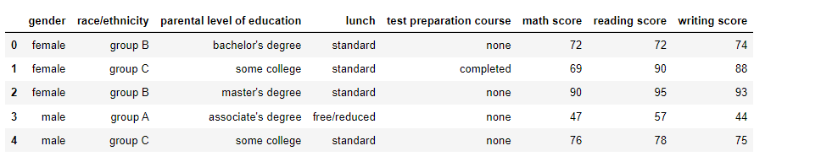
DTSA 5509 Supervised Learning Final Project.
Project Name : Student Performance Modeling Using Non-Academic Data.
Data Source :- https://www.kaggle.com/datasets/allexanderspb/studentsperformance
Data Layout : -

Slide 2
Problem Statement : -
Educational institutions strive to understand the factors that contribute to student success to create a nurturing and fulfilling learning environment. While academic performance serves as a crucial indicator of success, institutions are also interested in exploring how non-academic aspects of a student's life can influence their achievements.
Regression / Classification : -
Initially, we plan to build a regression model to predict the average score based on non-academic features. However, since the threshold value for success may vary across institutions, a classification model with a fixed threshold might not be appropriate. Through regression modeling, we aim to examine the relationship between non-academic factors and a student's academic accomplishments. Nonetheless, we will address why a regression model may not be ideal for this specific dataset. and we consider building Classification Model.

Slide 3
Interesting Observation : -
No proper response/target variable .
Next Steps : -
Univariant Exploratory Data Analysis.
Outlier Identification And Remove
Null Imputation
Bivariant EDA ( Correlation between features)
Multicollinearity Analysis
Feature Engineering
Identify Categorical And Numerical Feature/Predictor
Convert Categorical To Numerical using diff techniques.
One Hot Encoding
Label Encoding
Feature Selection

Slide 4
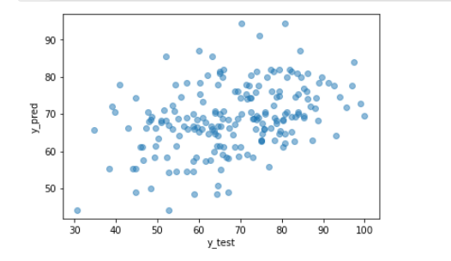
Derived Response/Target Variable For Regression and Classification
## Regresion Problem
df['average_score'] = (df['math score'] + df['reading score'] + df['writing score'])/3
df['average_score’] (Continues Variable)
##Classification Problem
cutoff = df['math score'].quantile(q=0.5) + df['reading score'].quantile(q=0.5) + df['writing score'].quantile(q=0.5)
df['success'] = np.where(df['math score'] + df['reading score'] + df['writing score'] > cutoff, 1, 0)
Regression Conclusion : ( Not Valid Approach)
* Linear Regression
* Random Forest (Regression)
First of all, no linear relationship exists between predictor and response.
Low Accuracy .

Slide 5
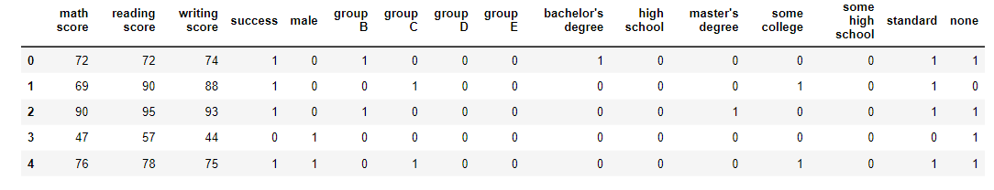
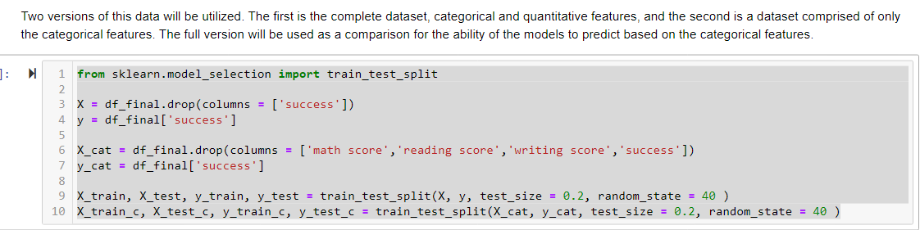
Data For Classification :-

Slide 6
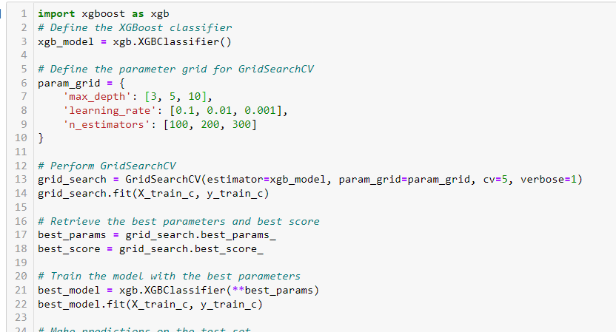
Model Selection:
Logistic Regression
KNN
Xgboost
Hyperparameter Tunning :-

Slide 7
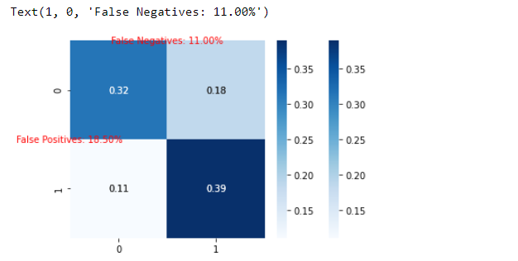
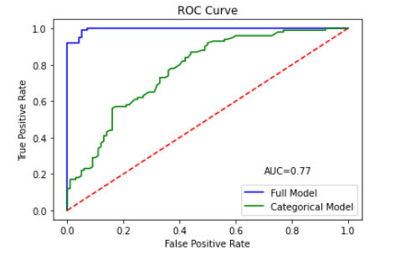
Model Evaluation :-

Slide 8
Conclusion :-
Using Non-Academic predictor/features model accuracy is not coming very high but around 70% accuracy is indicating that Student non-academic features are also very important for performance.
But Understanding the role that demographics play is crucial in providing enough support to students who are in danger of being misclassified.
How Institute Can Use This Model :-
A modeling procedure like this can be used to identify those students who would be classified incorrectly, allow for further examination of their record, and provide guidance in proactively offering services to assist those students in order to achieve at their highest potential.

